Slide 1
Introduction to CV & CG
Ming-Ming Cheng
http://mmcheng.net/icv/
Acknowledgement: The materials from this class reply significantly on slides prepared by other instructors: J Hays, D. Hoiem, S. Lazebnik, A. Efros, S. Seitz, D. Forsyth and the vision course at Brown.

Slide 2
Today’s Class
What is Computer Vision?
What is Computer Graphics?
Research in Media Computing lab
What should I do during my college study?

Slide 3
Computer Vision

Slide 4
What is Computer Vision?
What are examples of computer vision being used in the world?

Slide 5
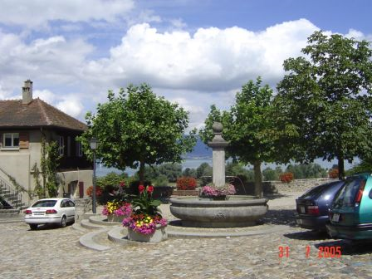
Computer Vision
Make computers understand images and video.
What kind of scene?
Where are the cars?
How far is the building?
…

Slide 6
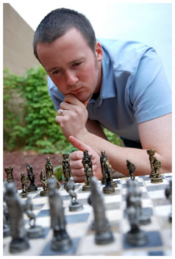
Vision is really hard
Vision is an amazing feat of natural intelligence
Visual cortex occupies about 50% of Macaque brain
More human brain devoted to vision than anything else
Is that a queen or a bishop?

Slide 7
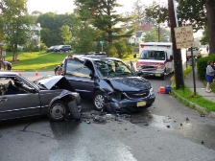
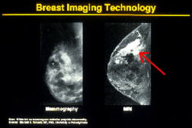
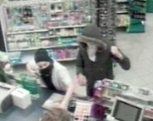
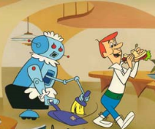
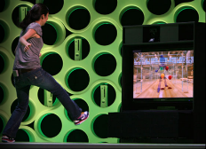
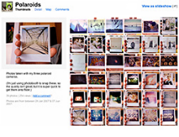
Why computer vision matters
Safety
Health
Security
Comfort
Fun
Access

Slide 8
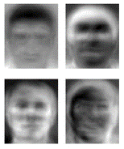
Brief history of computer vision
1966: Minsky assigns computer vision as an undergrad summer project
1960’s: interpretation of synthetic worlds
1970’s: some progress on interpreting selected images
1980’s: ANNs come and go; shift toward geometry and increased mathematical rigor
1990’s: face recognition; statistical analysis in vogue
2000’s: broader recognition; large annotated datasets available; video processing starts
2030’s: robot uprising?
Guzman ‘68
Ohta Kanade ‘78
Turk and Pentland ‘91

Slide 9
How vision is used now
Examples of state-of-the-art
Some of the following slides by Steve Seitz

Slide 10
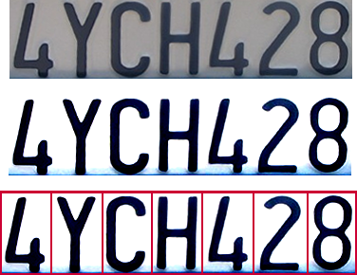

OCR
Convert scanned docs to text
If you have a scanner, it probably came with OCR software
Digit recognition, AT&T labs
http://www.research.att.com/~yann/
License plate readers
http://en.wikipedia.org/wiki/Automatic_number_plate_recognition

Slide 11
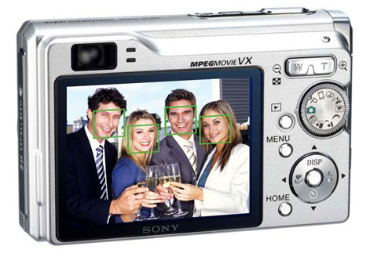
Face detection
Many new digital cameras now detect faces
Canon, Sony, Fuji, …
Notes:
Why would this be useful? Main reason is focus. Also enables “smart” cropping.

Slide 12
Smile detection
Sony Cyber-shot® T70 Digital Still Camera

Slide 13
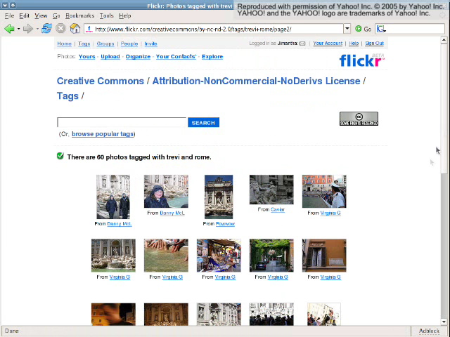
3D from thousands of images
Photo Tourism: Exploring Photo Collections in 3D. 2006

Slide 14
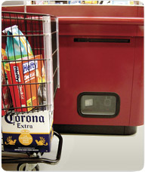
Object recognition (in supermarkets)
LaneHawk by EvolutionRobotics
“A smart camera is flush-mounted in the checkout lane, continuously watching for items. When an item is detected and recognized, the cashier verifies the quantity of items that were found under the basket, and continues to close the transaction. The item can remain under the basket, and with LaneHawk, you are assured to get paid for it… “

Slide 15
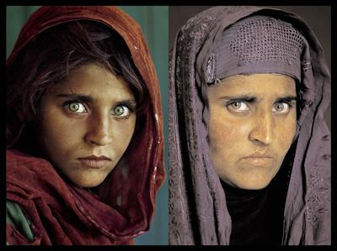
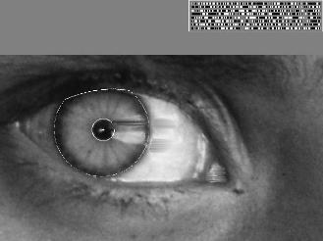
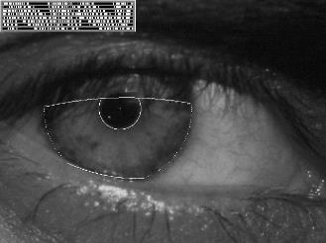
Vision-based biometrics
“How the Afghan Girl was Identified by Her Iris Patterns” Read the story wikipedia
Notes:
Age 12, Age 30

Slide 16
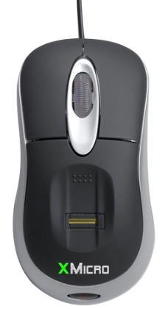
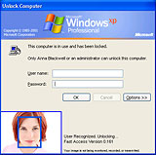
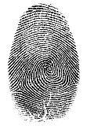

Login without a password…
Fingerprint scanners on many new laptops, other devices
Face recognition systems now beginning to appear more widely http://www.sensiblevision.com/

Slide 17
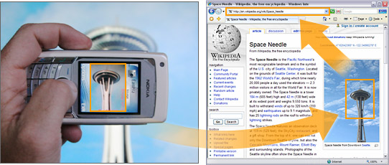
Object recognition (in mobile phones)
Point & Find, Nokia Google Goggles

Slide 18
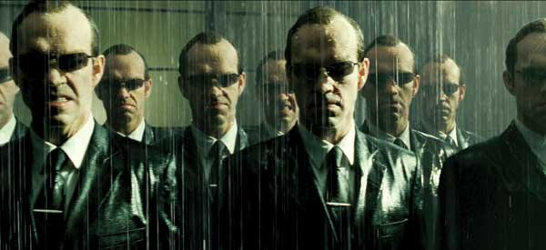
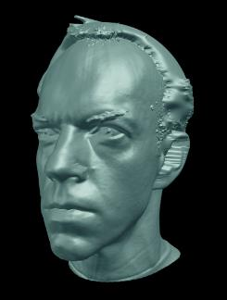
Special effects: shape capture
The Matrix movies, ESC Entertainment, XYZRGB, NRC

Slide 19
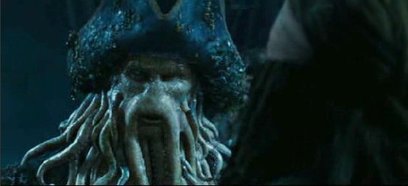
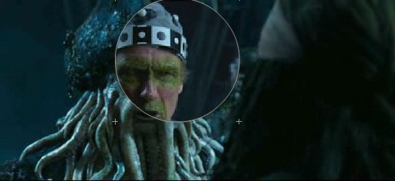
Special effects: motion capture
Pirates of the Carribean, Industrial Light and Magic

Slide 20
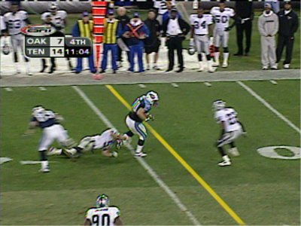
Sports
Sportvision first down line
Nice explanation on www.howstuffworks.com
http://www.sportvision.com/video.html

Slide 21
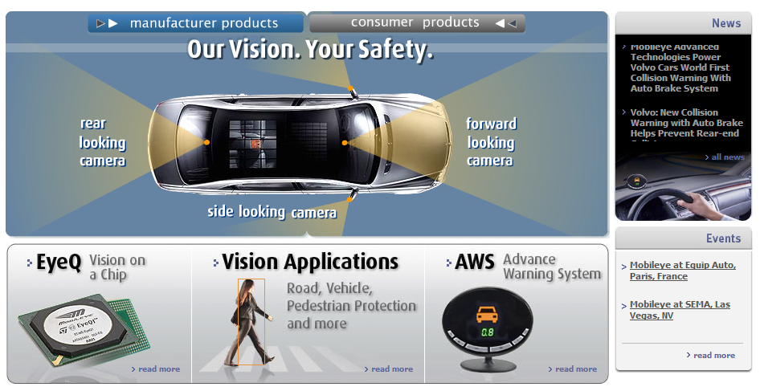
Smart cars
Mobileye
Vision systems currently in high-end BMW, GM, Volvo models
By 2010: 70% of car manufacturers.
Slide content courtesy of Amnon Shashua

Slide 22
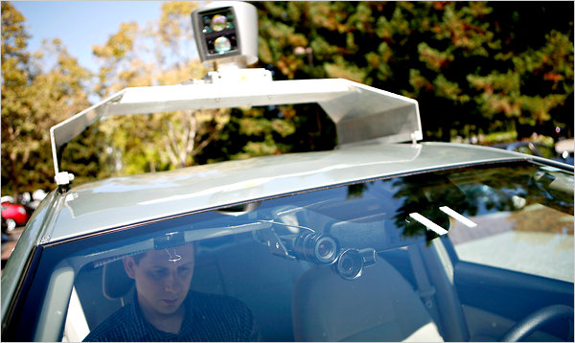
Google cars
Oct 9, 2010. "Google Cars Drive Themselves, in Traffic". The New York Times. John Markoff
June 24, 2011. "Nevada state law paves the way for driverless cars". Financial Post. Christine Dobby
Aug 9, 2011, "Human error blamed after Google's driverless car sparks five-vehicle crash". The Star (Toronto)

Slide 23
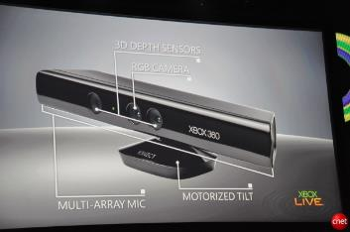
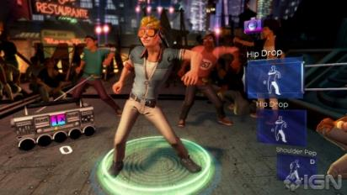
Interactive Games: Kinect
Object Recognition: http://www.youtube.com/watch?feature=iv&v=fQ59dXOo63o
Mario: http://www.youtube.com/watch?v=8CTJL5lUjHg
3D: http://www.youtube.com/watch?v=7QrnwoO1-8A
Robot: http://www.youtube.com/watch?v=w8BmgtMKFbY

Slide 24
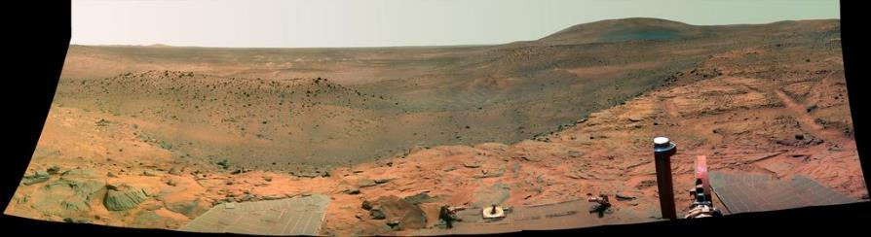
Vision in space
NASA'S Mars Exploration Rover Spirit captured this westward view from atop a low plateau where Spirit spent the closing months of 2007.
Vision systems (JPL) used for several tasks
Panorama stitching
3D terrain modeling
Obstacle detection, position tracking
For more, read “Computer Vision on Mars” by Matthies et al.

Slide 25
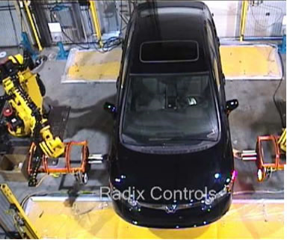
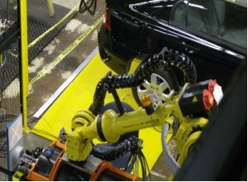
Industrial robots
Vision-guided robots position nut runners on wheels

Slide 26
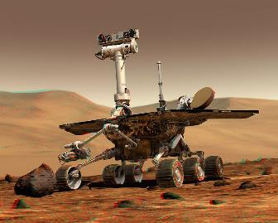
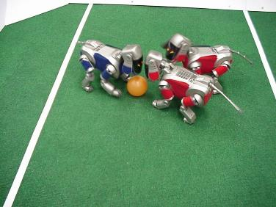
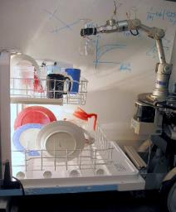
NASA’s Mars Spirit Rover
http://en.wikipedia.org/wiki/Spirit_rover
http://www.robocup.org/
Saxena et al. 2008
STAIR at Stanford

Slide 27
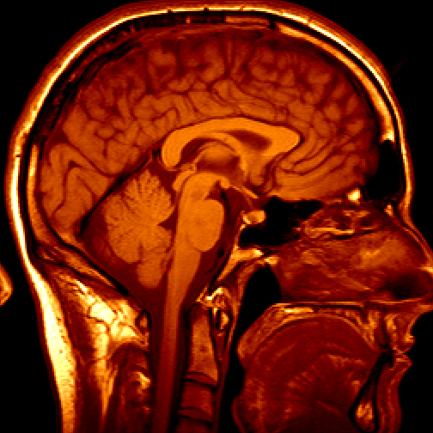
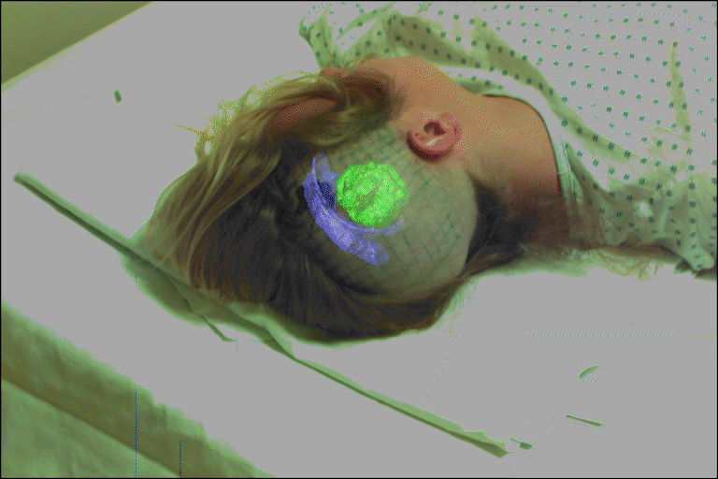
3D imaging
MRI, CT
Image guided surgery
Grimson et al., MIT

Slide 28
Computer Vision and Nearby Fields
Computer Graphics: Models to Images
Comp. Photography: Images to Images
Computer Vision: Images to Models

Slide 29
Computer Vision
Robotics
Machine Learning
Human Computer Interaction
Graphics
Image Processing Feature Matching Recognition
…
Medical Imaging
Computational Photography
Optics
Neuroscience

Slide 30
Computer Graphics

Slide 31
Why we need graphics?
Will graphics die?

Slide 32
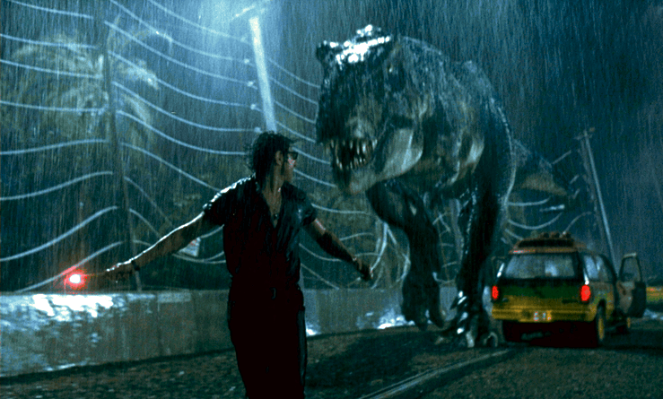
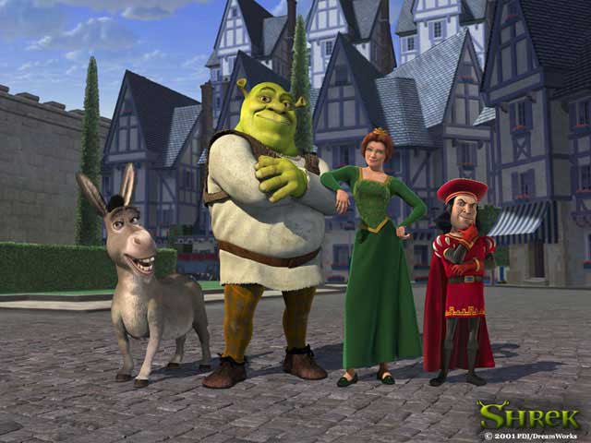
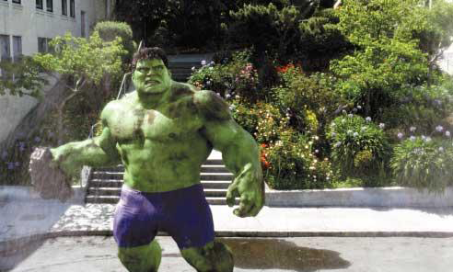

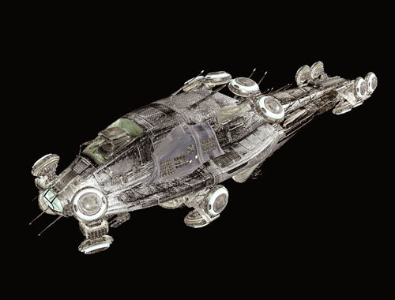
Movie industry
Notes:
Graphics has been widely used in movie industry, we can see many fantastic scenes, even the whole movie produced by Graphics system. Such as “Nemo”, “Shrek”,
------------------------------
Movies:
As the image making capabilities advanced during the move from the lab to full scale production in the 1970s, Hollywood took notice. There were several movies that included one or more special effects scenes that were computer graphics.
For example, John Whitney Jr. produced some graphics effects for Michael Crichton's Westworld in 1973; Information International Inc (III) produced a 3D representation of Peter Fonda's head for the movie Futureworld in 1976; Susan Dey was digitized by III for several scenes in Looker; Larry Cuba produced a scene for Star Wars, and another scene was done with Scanimate; John Whitney, Sr., R/Greenberg and others produced graphics for titles, including the famous Superman titles; Disney's The Black Hole used a 3D effect for the opening and for some trailers; the Genesis Effect was produced by Lucasfilm for Star Trek: the Wrath of Khan in 1982.
There are a lot of computer graphics recent movies which I think you are familiar with,
Such as “Nemo”, “Shrek”, “I, Robot”, “Garfield I/II”, “the Incredibles”, “Cars” and so on.

Slide 33
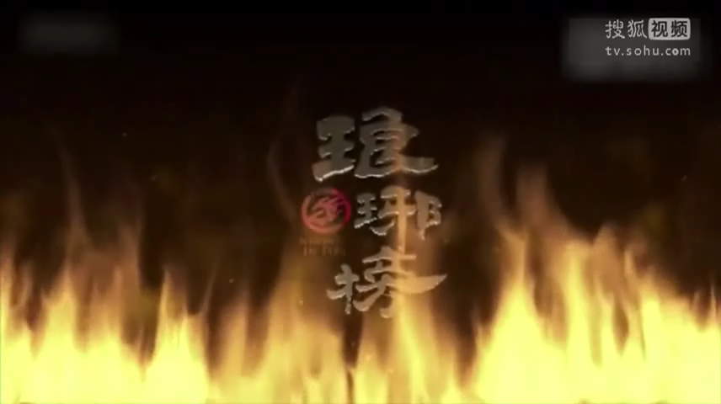
Movie industry

Slide 34
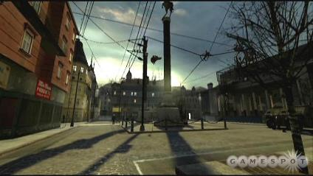
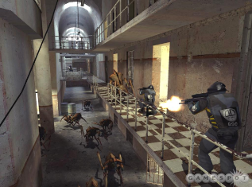
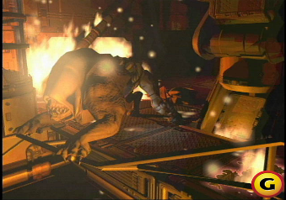
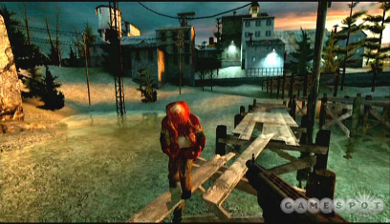
Video games

Slide 35
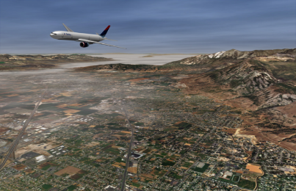
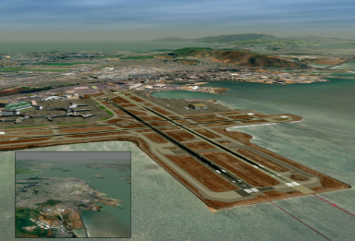
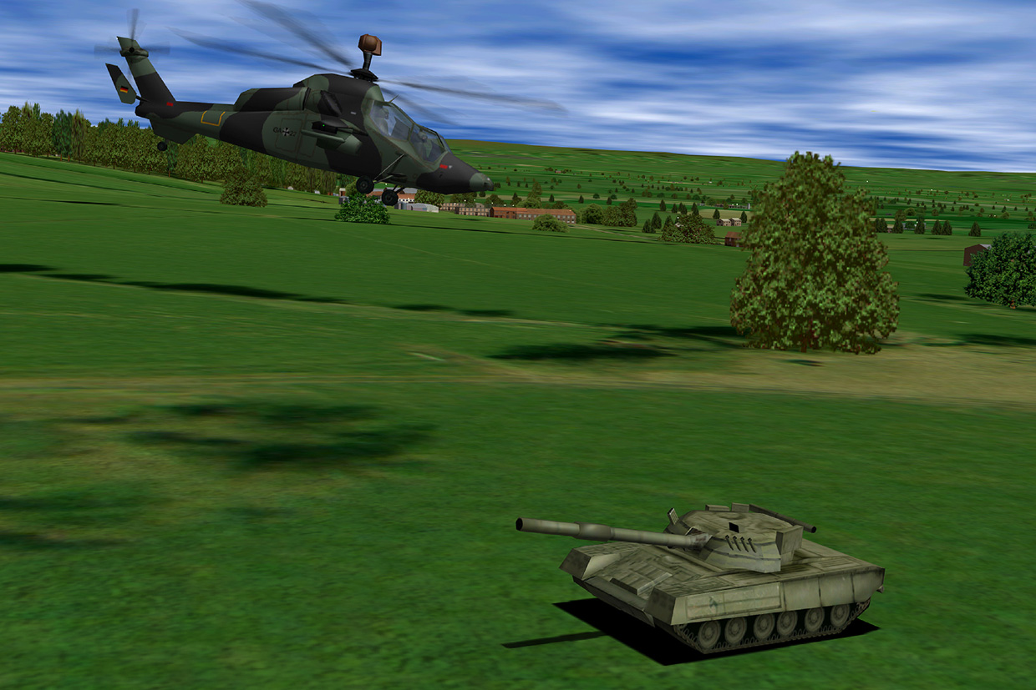
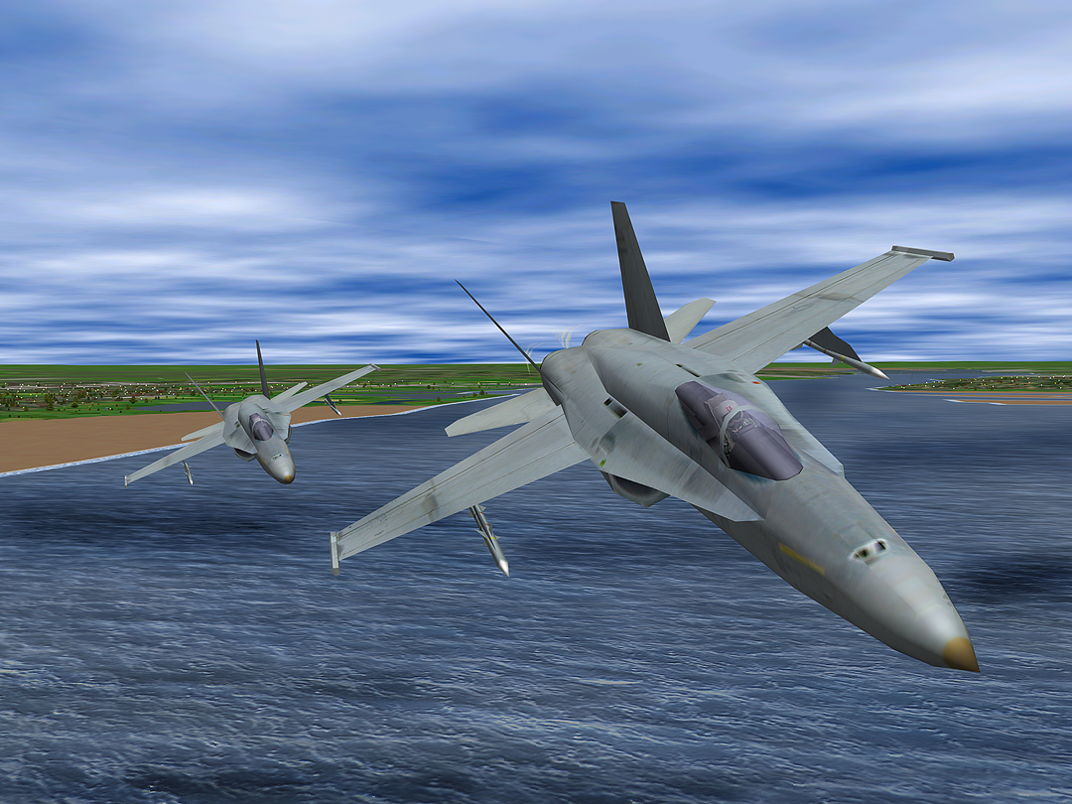
Simulation

Slide 36




CAD

Slide 37



Architecture design

Slide 38


Visualization

Slide 39
What is computer graphics
Computer Graphics is a subject to
investigate graphics representation,
generation,
processing
and display by using Computers.
One of the most active branch in CS
Modeling
Animation
Rendering
Notes:
Computer graphics is a sub-field of computer science and is concerned with digitally synthesizing and manipulating visual content. Although the term often refers to three-dimensional computer graphics, it also encompasses two-dimensional graphics and image processing. Graphics is often differentiated from the field of visualization, although the two have many similarities. Entertainment (in the form of animated movies and video games) is perhaps the most well-known application of graphics.
Some major subproblems in computer graphics include:
describing the shape of an object (modeling)
describing the motion of an object (animation)
creating an image of an object (rendering)

Slide 40
Conferences
Siggraph, Eurograph, Pacific Graphics, Computer Graphics International, Graphics Interface
Journal
ACM Transaction on Graphics
IEEE Visualization and Computer Graphics
IEEE Computer Graphics and Application
Graphical Models
Computer Graphics Forum
The Visual Computer

Slide 41


Viewing and transformation
Modeling
Viewing
Transformation
Notes:
This chapter will discuss the mathematics of viewing and transformation in computer graphics.
The basis purpose of these transformations is to provide methods of changing positions, directions and shapes of objects and changing of directions and positions of view points.
As shown in the upper figure, after modeling, we get a 3D these; after specifing a view transformation we could get a rendered 2D image. The latter image shows the transformation of a fish model.
An obvious use of transformations is to help simplify the task of geometric modeling. For
example, suppose an artist is designing a computerized geometric model of a Ferris wheel.
A Ferris wheel has considerable symmetry and includes many repeated elements such as
multiple cars and struts. The artist could design a single model of the car and then place
multiple instances of the car around the Ferris wheel attached at the proper points. Similarly,
the artist could build the main structure of the Ferris wheel by designing one radial “slice” of
the wheel and using multiple rotated copies of this slice to form the entire structure.
A second important use of transformations is to describe animation. Continuing with the
Ferris wheel example, if the Ferris wheel is animated, then the positions and orientations of its
individual geometric components are constantly changing. Thus, for animation, it is necessary
to compute time-varying affine transformations to simulate the motion of the Ferris wheel.
A third, more hidden, use of transformations in computer graphics is for rendering. After a
3-D geometric model has been created, it is necessary to render it on a two-dimensional surface
called the viewport. Some common examples of viewports are a window on a video screen, a
frame of a movie, and a hard-copy image. There are special transformations, called perspective
transformations, that are used to map points from a 3-D model to points on a 2-D viewport.

Slide 42


Spline curve
Notes:
A spline curve is a smoothcurve specified succinctly in terms of a few points. These two
aspects of splines, that they are smooth and that they are specified succinctly in terms of only
a few points, are both important. First, the ability to specify a curve with only a few points
reduces storage requirements. In addition, it facilitates the computer-aided design of curves and
surfaces because the designer or artist can control an entire curve by varying only a few points.
Second, the commonly used methods for generating splines give curves with good smoothness
properties and without undesired oscillations. Furthermore, these splines also allow for isolated
points where the curve is not smooth, such as points where the spline has a “corner.” A third
important property of splines is that there are simple algorithms for finding points on the spline
curve or surface and simple criteria for deciding how finely a spline must be approximated by
linear segments to obtain a sufficiently faithful representation of the spline. The main classes
of splines discussed in this semester are the Bezier curves and the B-spline curves.

Slide 43


Triangle Mesh
A representation for 3D models in CG.
A set of triangles (typically in 3D) that are connected by their common edges.
Notes:
triangle mesh is a representation for 3D models in computer graphics , which is mostly used current days.
It comprises a set of triangles (typically in three dimensions) that are connected by their common edges.
Many graphics software packages and hardware devices can operate more efficiently on triangles than other type of primitives.
With individual triangles, the system has to operate on three vertices for every triangle. In a large mesh, there could be eight or more triangles meeting at a single vertex - by processing those vertices just once, it is possible to do a fraction of the work and achieve an identical effect.
By using enough number of triangles and vertices, triangle meshes could represent a 3D model almost correctly. As shown in the figure, the left is a teapot, the right is a bunny, both are represent by triangle meshes.

Slide 44





Deformation
Notes:
Deformation and Animation is a hot topic in computer graphics.
Deformation is referred to as deforming from one 3D model to another one, by a simple interaction with the 3D model, as shown in the figures.
Deformable models have two decades of history in Computer Graphics. Numerous researchers have partaken in the quest for the visually and physically plausible animation of
deformable objects and fluids. This inherently interdisciplinary
field elegantly combines newtonian dynamics, continuum
mechanics, numerical computation, differential geometry,
vector calculus, approximation theory and Computer
Graphics (to name a few) into a vast and powerful toolkit,
which is being further explored and extended. The field is in
constant flux and, thus, active and fruitful, with many visually
stunning achievements to account for.

Slide 45




Lighting & Shading
Notes:
Lighting and shading are important tools for making graphics images appear more realistic and
more understandable. Lighting and shading can provide crucial visual cues about the curvature
and orientation of surfaces and are important in making three-dimensionality apparent in a
graphics image. Indeed, good lighting and shading are probably more important than correct
perspective in making a scene understandable.
Lighting and illumination models in computer graphics are based on a modular approach
wherein the artist or programmer specifies the positions and properties of light sources,
and, independently, specifies the surface properties of materials. The properties of the lights
and the materials interact to create the illumination, color, and shading seen from a given
viewpoint.
This chapter will discuss various lighting models used in computer graphics.
As in the figure, all the teapots in the 4 images are using different data-driven BRDF models.

Slide 46

Ray Tracing
Performs, by a single unified technique,
global calculations of lighting and shading,
hidden surface elimination,
reflection and transmission of light,
casting of shadows, etc.

Slide 47


Ray Tracing
Notes:
Ray tracing is a technique that performs, by a single unified technique, global calculations of
lighting and shading, hidden surface elimination, reflection and transmission of light, casting
of shadows, and other effects. As such, it significantly extends the local lighting models. Ray tracing also eliminates
the use of a depth buffer for hidden surface determination. In addition, it allows for many
special effects and can create images that are more realistic looking than those that can be
easily obtained by the methods we have discussed so far.
The basic idea behind ray tracing is to follow the paths of light rays around a 3-D scene.
Typically, one follows the light rays’ paths from the position of the viewer back to their source.
When light rays hit objects in the 3-D scene, one computes the reflection direction for the light
ray and continues to follow the light ray in the reflection direction. Continuing this process,
perhaps through multiple reflections (and possibly transmissions through transparent media),
one can trace the path of a light ray from its origination at a light source until it reaches the
view position.
We will discuss the basis idea of ray tracing and several advanced techniques as well.

Slide 48

Hierarchical Structure
Notes:
(In the figure, is a hierarchical structure called octree (八叉树))
However, the biggest disadvantage of ray tracing is that it is too slow, especially for large scenes.
In this chapter, we will discuss several techniques to accelerate ray tracing, such as BSP tree, octree, and so on.

Slide 49


Texture
Notes:
(Image: Left, no texture, Right, with texture)
Texture exhibits great realistics in rendering.
Texture mapping, in its simplest form, consists of applying a graphics image, a picture, or a
pattern to a surface. A texture could, for example, apply an actual picture to a surface such
as a label on a can or a picture on a billboard or can apply patterns suchas wood
grain or stone surfaces.
More generally, a texture can hold any kind of information that affects the appearance of a surface: the texture map serves as a precomputed table, and the
texture mapping then consists simply of table lookup to retrieve the information affecting a
particular point on the surface as it is rendered. If you do not use texture maps, your surfaces
will either be rendered as very smooth, uniform surfaces or will need to be rendered with very
small polygons so that you can explicitly specify surface properties on a fine scale.
In this chapter, we will discuss 2D-textures, high dimensional textures and texture synthesis techniques.

Slide 50



Shadow
Notes:
Shadows are important elements in creating realistic images and in providing the user with visual cures about object placement.
Shadows in graphics could be category into hard shadows (cause by a point/directional light source),
soft shadows (by a area light source) and environment map shadows( by full environment lighting).
However, computing shadow effects for lighting scenes is difficult because it involves full visibility testing/ray-intersection in each pixel/vertex, which is computational expensive.
In this chapter, we will discuss different techniques for generating hard/soft/environemnt map shadow.

Slide 51


Radiosity (辐射度)
Notes:
Radiosity is a global lighting method that tracks the spread of diffuse light around a scene. As
a global lighting method, it attempts to simulate the effect of multiple light reflection. Unlike
basic ray tracing, which tracks only the specular transport of light, radiosity tracks only the
diffuse transport of light.
Radiosity methods are, in many ways, complementary to ray tracing methods. Basic ray
tracing tracks the global transport of specularly reflected light, whereas radiosity tracks the
global transport of diffusely reflected light. Thus, radiosity is much better at softly lit scenes
with subtle color shading, whereas ray tracing is better at rendering sharp shadows. Radiosity
methods usually track the diffusely reflected light by starting at the light source and tracking the
movement of illumination forward. Ray tracing generally starts at the view point position and
tracks rays of light backwards (in the so-called forward ray tracing). For this reason, the results
of ray tracing are view dependent, whereas the results of radiosity are view independent. Thus,
radiosity can be used to preprocess a scene ahead of time, and once the radiosity algorithm
is completed the scene can be traversed in real time without expensive computation. This
means that radiosity is well suited to interactive walkthrough applications. By comparison, ray
tracing cannot generally be viewed by a moving viewer in realtime, since the entire ray tracing
procedure must be repeated for each change in the view position.

Slide 52

Mesh simplification

Slide 53

Image based rendering

Slide 54

Model rendering

Slide 55


Physical based rendering of Gemstones

Slide 56
Point based rendering of large scenes

Slide 57

Image Morphing

Slide 58
Image deformation

Slide 59

Video based animation

Slide 60

Skeleton-Based Seam Computation

Slide 61

Texture

Slide 62

Registration
Reassembling Fractured Objects by Geometric Matching, ACM SIGGRAPH 2006, Huang et al.

Slide 63
Research in Media Computing lab

Slide 64





About me

Slide 65


Slide 66


ImageSpirit
ImageSpirit: Verbal Guided Image Parsing, ACM TOG, 2014, M.M. Cheng et. al.

Slide 67



ImageSpirit: motivation

Slide 68






ImageSpirit
Make the wood cabinet in bottom-middle lower
nouns
Adjective
Verb/Adverb
Object Attributes
Commands
Multi label CRF

Slide 69

Semantic Paint

Slide 70

SemanticPaint
SemanticPaint: Interactive 3D Labeling and Learning at your Fingertips, conditional accepted by ACM TOG.
Video demo
[Online version]
[Local version]

Slide 71

Example: new problem
T Chen, MM Cheng, P Tan, A Shamir, SM Hu, Sketch2photo: internet image montage, ACM TOG. (SIGGRAPH Asia), vol. 28, no. 5, 124:1-10, 2009.

Slide 72

Sketch2Photo

Slide 73

Salient object detection
MM Cheng, GX Zhang, NJ Mitra, X Huang, SM Hu, Global Contrast based Salient Region Detection, IEEE CVPR, p. 409-416, June 21-23, 2011.

Slide 74

Object proposal
BING: Binarized Normed Gradients for Objectness Estimation at 300fp, IEEE CVPR 2014 (Oral), M.M. Cheng, et. al.

Slide 75
What should I do during my college study?

Slide 76
Thanks

Slide 77
Graphics and CAD
Professor Coons, the concept of “CAD”
(Computer Aided Design) in 1958,
Coons surface in 1964,
Coons Award
Notes:
ACM SIGGRAPH has an award named for Coons. The Steven Anson Coons Award for Outstanding Creative Contributions to Computer Graphics is given in odd-numbered years to an individual to honor that person's lifetime contribution to computer graphics and interactive techniques. It is considered the field's most prestigious award.

Slide 78

The 1950’s
In 1950, the first visual display unit is designed for MIT’s Whirlwind I Computer
In 1958, CalComp developed 565 drum plotter (滚筒绘图仪)
Notes:
50年代
1950年，第一台图形显示器作为美国麻省理工学院（MIT）旋风I号（Whirlwind I）计算机的附件诞生。
1958年，美国Calcomp公司由联机的数字记录仪发展成滚筒式绘图仪，GerBer公司把数控机床发展成为平板式绘图仪。
50年代末期，MIT的林肯实验室在“旋风”计算机上开发SAGE空中防御体系。

Slide 79

The 1960’s
Ivan Sutherland’s PhD Thesis
In 1962, MIT’s Lincoln Lab
Sketchpad: A Man-Machined Graphical Communication System
“The father of computer graphics”
Turing Award in 1988
Movie for PHD defense: “PPT”
Notes:
Ivan Sutherland
Sketchpad
Ivan Sutherland using Sketchpad, the first truly interactive computer graphics system. The user of Sketchpad, the precursor of all modern interactive computer graphics systems, was able to draw with a light pen on the computer screen and see the results almost immediately.
Ivan Sutherland is considered by many to be the father of computer graphics. He introduced such concepts as 3-D computer modeling, visual simulation, computer-aided design (CAD), and virtual reality. Sutherland's work in computer graphics began with his Ph.D. thesis, "SketchPad," the first graphical user interface, which he developed for the arcane TX-2 computer.
After receiving his doctoral degree, Sutherland spent time at the National Security Agency (NSA) and the Defense Department's Advanced Research Project's Agency (ARPA), where he commissioned computing projects in concepts such as time-sharing and artificial intelligence. In 1966, he became a professor at Harvard, which he left two years later to become a professor at the University of Utah, where he built that school's reputation for computer graphics. In 1976, he became head of the computer science department at the California Institute of Technology (Caltech), where he helped introduce integrated circuit design to the curriculum, which in turn spurred the explosion of chip design and manufacturing in California's Silicon Valley.
Sutherland co-founded two companies, Evans & Sutherland Computer Corporation and Sutherland, Sproull & Associates. The first is still an independent, publicly traded company producing computer graphics, simulation, and engineering technology. The second was purchased by Sun Microsystems, Inc. after ten years in business and renamed Sun Laboraties; Sutherland is still employed as a vice president and fellow by Sun Microsystems. Among his awards is the A.M. Turing Award of the Association for Computing Machinery (ACM), which he received in 1988. He is a member of the National Academy of Sciences and a fellow of the ACM, and he has authored approximately 50 publications.
Sutherland obtained a BS in electrical engineering from Carnegie Mellon University in 1959 and an MS in electrical engineering from CalTech in 1960. He earned a Ph.D. from the Massachusetts Institute of Technology in 1963. He also has an honorary MA from Harvard.

Slide 80
The 1960’s
Pierre Bezier (a French engineer)
Bezier curves and Bezier surfaces that are now used in most CAD and CG systems
UNISUR system for Car design
ACM SIGGRAPH Coons’ award in 1985
Bezier and de Casteljau
Bezier and Forrest

Slide 81
The 1970’s
Fast development of Rasterizing Graphics
Scan conversion
Clipping
Surface hidden removal
…
Standardization
In 1974, ACM SIGGRAPH formed the Graphics Standard Committee.
Core Graphics System
ISO published CGI, CGM, GKS, PHIGS
Notes:
70年代
光栅图形学迅速发展
区域填充、裁剪、消隐等基本图形概念、及其相应算法纷纷诞生
图形软件标准化
1974年，ACM SIGGRAPH的与ACM成立图形标准化委员会，制定“核心图形系统”（Core Graphics System）
ISO发布CGI、CGM、GKS、PHIGS

Slide 82
The 1970’s (Rendering)
In 1970, Bouknight
The first lighting reflection model (flat shading)
In 1971, Gourand
“diffuse reflection + interpolation ”, which is called as Gourand shading
In 1975, Phong
Local lighting model, which is called as Phong lighting model. (one of the most important and influential lighting model).
Notes:
1970年，Bouknight提出了第一个光反射模型
1971年Gourand提出“漫反射模型＋插值”的思想，被称为Gourand明暗处理
1975年，Phong提出了著名的简单光照模型- Phong模型

Slide 83
The 1980’s (Ray tracing & Radiosity)
In 1980, Whitted
A ray tracing model, include light reflection and transmission effects
In 1984, Cornell Uni. and Hiroshima Uni.
The concept and methods of radiosity in the field of heat radiation to computer graphics
Greenberg and Nishita
Notes:
80年代
1980年Whitted提出了一个光透视模型-Whitted模型，并第一次给出光线跟踪算法的范例，实现Whitted模型
1984年，美国Cornell大学和日本广岛大学的学者分别将热辐射工程中的辐射度方法引入到计算机图形学中
Greenberg - Nishita
图形硬件和各个分支均在这个时期飞速发展

Slide 84
ACM SIGGRAPH
Special Interest Group on Computer Graphics and Interactive Techniques
In 1967, Andries van Dam professor at Brown Unversity and Sam Masta of IBM Corporation co-founded SIGGRAPH
In 1974, the first SIGGRAPH annual conference was held in University of Colorado
http://www.siggraph.org
Notes:
ACM SIGGRAPH会议小知识
全称 “the Special Interest Group on Computer Graphics and Interactive Techniques”
60年代中期，由Brown 大学的教授Andries van Dam (Andy) 和IBM公司的Sam Matsa发起
1974年，在Colorado大学召开了第一届SIGGRAPH 年会，并取得了巨大的成功
http://www.siggraph.org

